Slide 1


NMTA
Economic Forecast
November 9, 2011
Jim Hebert
Hebert Research, Inc.

Slide 2
2011 Nobel Prize Winners
Thomas Sargent and Christopher Sims
Structural Macroeconomic Model
    (X,Y) = (Y,X)
Mathematical Model - Rate of Change
Statistical Model - Historical Variables that do not change:
X= el+allX-1 + a21X-2 +BllYl + b21Y-2 + cllZ-1 + CZ ~ Z+ -el
Y= c2 + aEX-1 + a22X-2 + buy1 + b22Y-2 + CEZ-+ ~c22Z-2 + e2
Z= c3 + a13X-1 + ~ 2 ~X+- 2b i3Y-I + b23x2 + c ~ ~ + Z c2-3Z~-2 + e3

Slide 3
Market Demand Based on Conditional Probabilities
Where P(X_{i} │Y_{j}) = P_{ij} / (∑ P_{ij})
X₁ = Ability to purchase
X₂ = Willingness
X₂ = Delayed Decision

Slide 4
Demand Equation For Marine Products and Service
d = f {H_{p} + E_{u}}
    Where beta home price – 0.297
    Employment – 0.685
    R² = 0.878

Slide 5
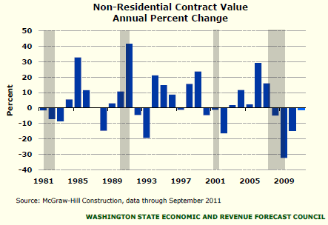
This is WA’s Worst Downturn in Non-Residential Construction in 30 years

Slide 6
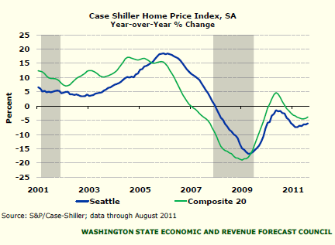
Single-Family Home Prices Continue to Decline

Slide 7
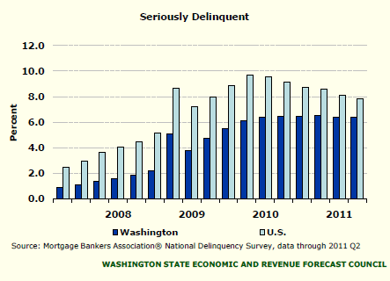
More Foreclosures Can Be Expected

Slide 8
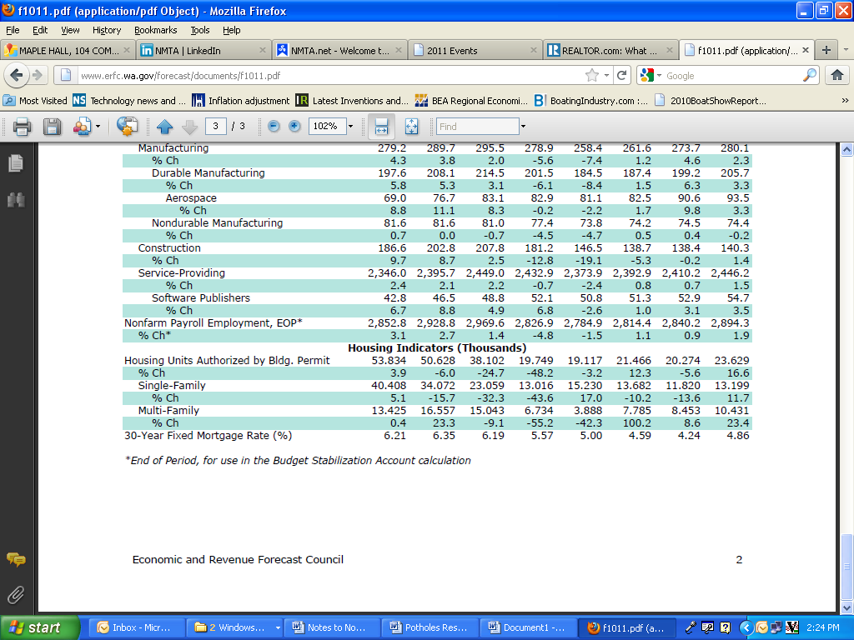
Housing Indicators
2006 | 2007 | 2008 | 2009 | 2010 | 2011 | 2012 | 2013

Slide 9
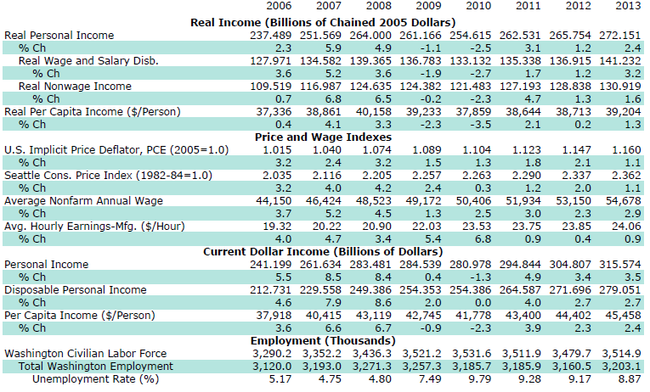
Income and Employment

Slide 10
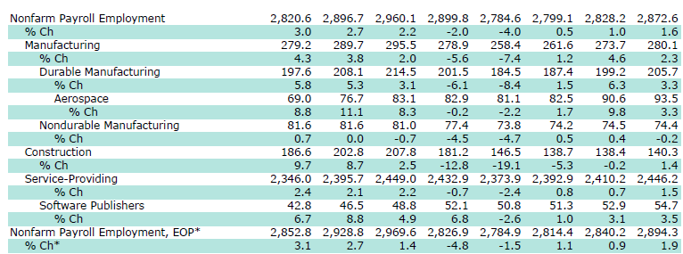
Nonfarm Payroll Employment
2006 | 2007 | 2008 | 2009 | 2010 | 2011 | 2012 | 2013

Slide 11
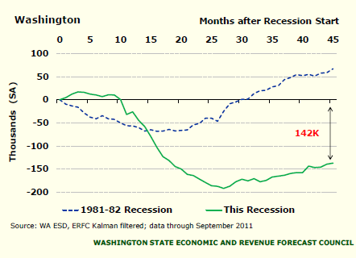
WA Employment is Still in the Hole

Slide 12
WA State Businesses
Full Time Employees
Mean | 42.49
Std. Deviation | 137.473
Kurtosis | 46.975

Slide 13
Unemployment Rate (% of Labor Force)
Unemployment Rate (Percent of Labor Force) | 2009 | 2010 | 2011 | 2012 | 2013
November Forecast, Preliminary | 9.30% | 9.60% | 9.20% | 9.10% | 8.60%

Slide 14
Education and Unemployment
Education | Unemployment Rate
Less than a high school education | 13.8%
High School graduate, no college | 9.6%
Some college or associate degree | 8.3%
Bachelor's degree or higher | 4.4%

Slide 15
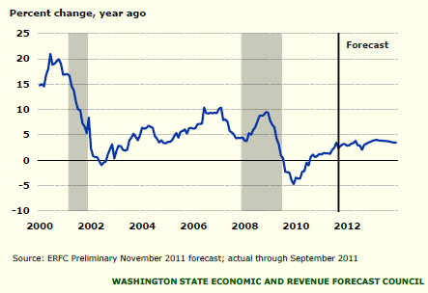
Software Publishing Employment is Growing

Slide 16
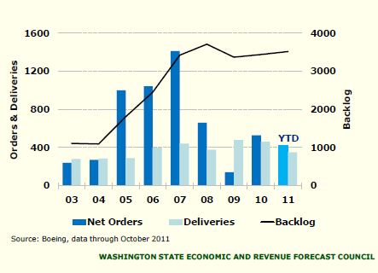
Boeing Has Over 7 Years of Commercial Orders on its Books

Slide 17
Manufacturing Employment
Manufacturing Employment (Thousands) | 2009 | 2010 | 2011 | 2012 | 2013
November Forecast, Preliminary | 265.5 | 257.9 | 268.1 | 277.1 | 282.8
Percent Change | -8.80% | -2.80% | 3.90% | 3.30% | 2.10%

Slide 18
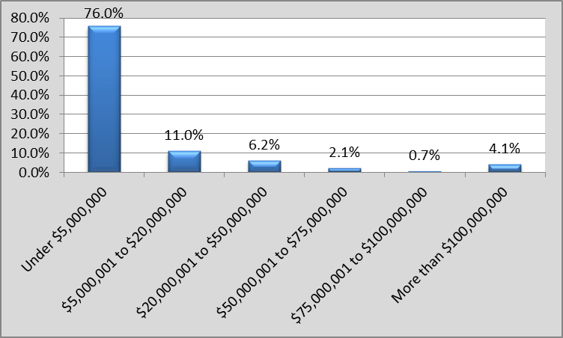
WA State Businesses
Annual Gross Revenue

Slide 19
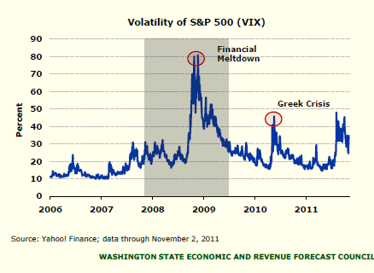
Stock Market Volatility has Spiked

Slide 20
M2 Money Stock

Slide 21
Current Market Conditions
 | Current | Last Week | Week change | Last Year | Year Change
Fed Funds | 0.25% | 0.25% | 0 | 0.25% | 0
Prime Rate | 3.25% | 3.25% | 0 | 3.25% | 0
Crude Oil | $94.16 | $93.96 | $0.20 | $84.69 | $9.47
Unleaded Gasoline | $2.65 | $2.71 | ($0.06) | $2.21 | $0.44

Slide 22
Confidence in Overall Economy
 | 11-Jan | 11-Apr | 11-Aug | 11-Nov
Mean | 5 | 5.2 | 4.4 | 5.17
Std. Deviation | 2.2 | 2.2 | 2 | 1.669
Kurtosis | 0.4 | 0.4 | 0.2 | -0.828

Slide 23
Future Health of the Economy
 | 11-Aug | 11-Nov
Mean | 5.2 | 5.52
Std. Deviation | 2 | 0.994
Kurtosis | 0.5 | 1.99

Slide 24
Total Revenue
 | 11-Aug | 11-Nov
Median | 0 | 2
Mean | 6.3 | 7.9
Std. Deviation | 23.8 | 22.6
Kurtosis | 6.5 | 15.2

Slide 25
Total Revenue

Slide 26
Expenses and Costs
 | 11-Aug | 11-Nov
Median | 3.5 | 5
Mean | 7.2 | 6.1
Std. Deviation | 16 | 6.8
Kurtosis | 21.6 | 2.2

Slide 27
Overall Business Climate
 | Q1 | Q2 | Q3
Mean | 4 | 4.1 | 4.45
Std. Deviation | 2.2 | 2.3 | 1.7
Kurtosis | -0.3 | -0.6 | 1.34

Slide 28
Federal Debt and Recovery

Slide 29
Consumer Price Index

Slide 30
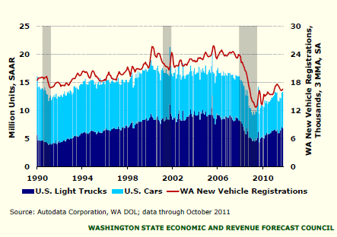
US LMV Sales are Recovering Slowly

Slide 31
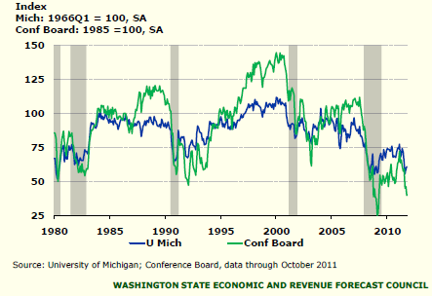
Consumer Confidence is Very Weak

Slide 32
Marine Industry Economic Impact for 2012
 | Economic value | Employment
Direct Impact | $2.2 b | 10,948
Indirect Impact | $826.4 M | 11,129
Induced Impact | $971.9 M | 6,481
Total Output | $3.998 b | 28,558

Slide 33
2011 Crisis of Confidence – C⁵
Consumer Confidence
Business Confidence
Investors Confidence
Government Confidence
International Confidence

